Slide 1

Where do reef sharks go when they’re not on reefs? and does it matter?
Andrew Chin¹, Colin Simpfendorfer¹, Michelle Heupel^{1,2}, Andrew Tobin¹
¹Centre for Sustainable Tropical Fisheries and Aquaculture
²Australian Institute of Marine Science

Slide 2

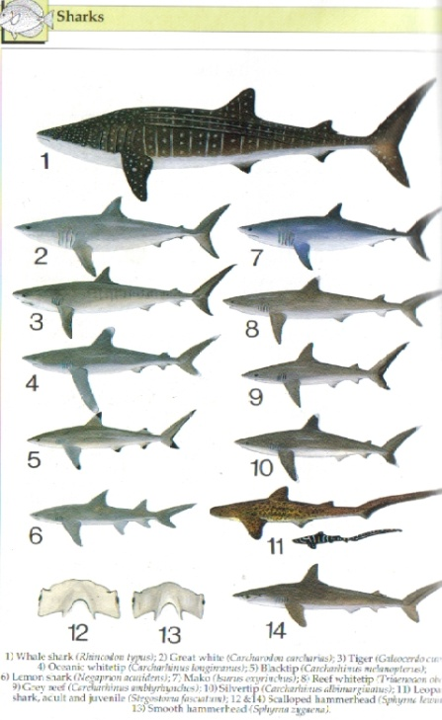
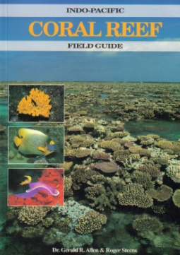
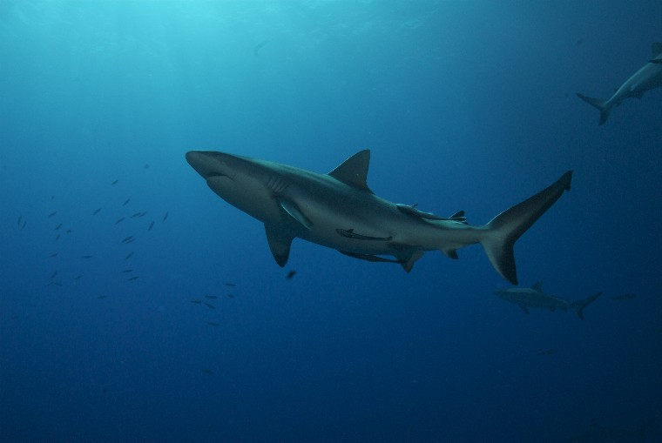
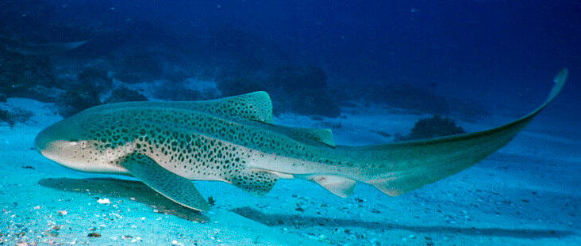
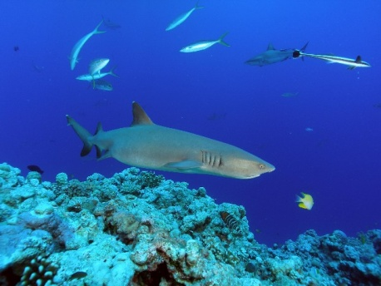
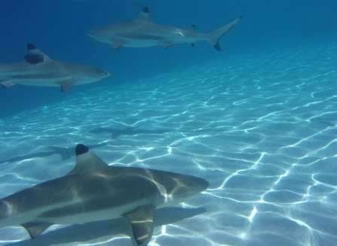

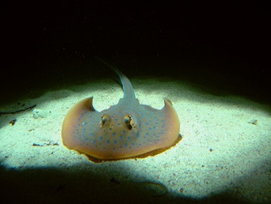
Defining reef sharks . . .
Sharks and rays that primarily occur on coral reefs
Implied dependence on reef habitats
Introduction Aims Methods Results Discussion Conclusions

Slide 3

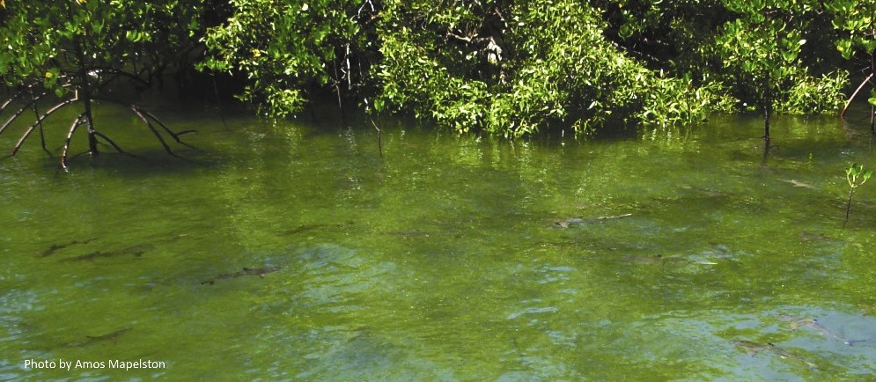
Occurrence in turbid coastal environments (TCEs)
Photo: Andrew Chin
Introduction Aims Methods Results Discussion Conclusions

Slide 4
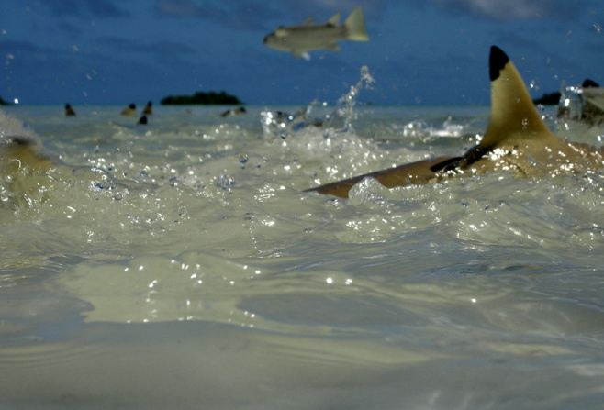
Does occurrence in TCEs matter?
Ecological effects . . . ???
Photo: Eric Benacek
Introduction Aims Methods Results Discussion Conclusions

Slide 5
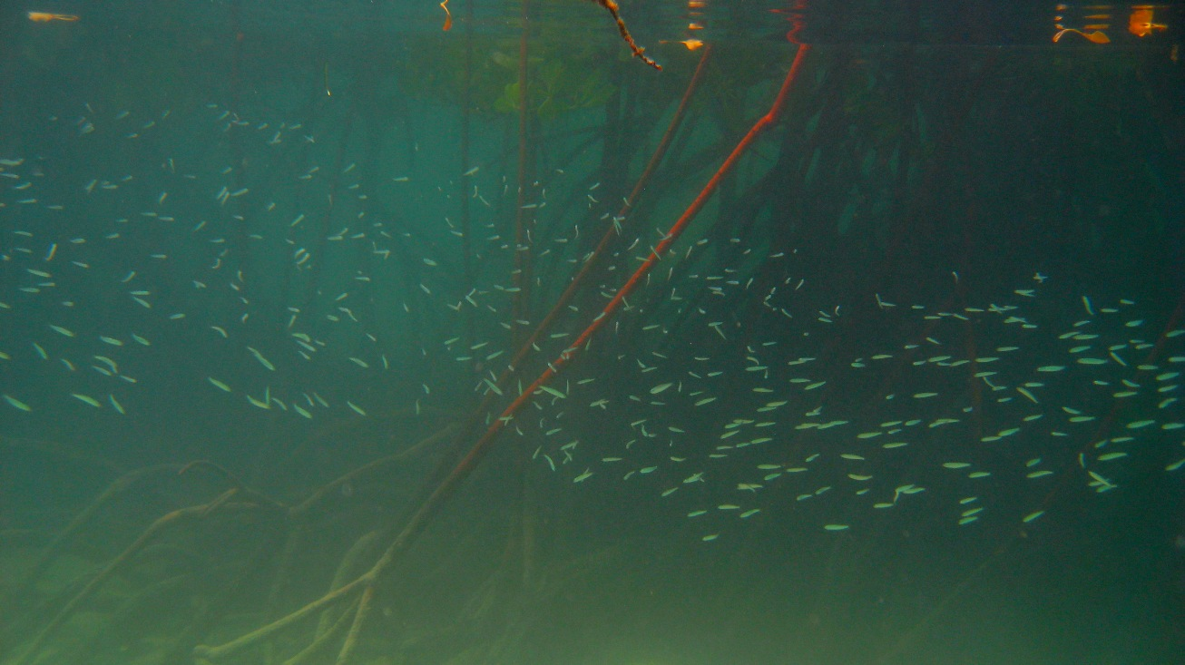
Does occurrence in TCEs matter?
Ecological roles . . . ???
Introduction Aims Methods Results Discussion Conclusions

Slide 6
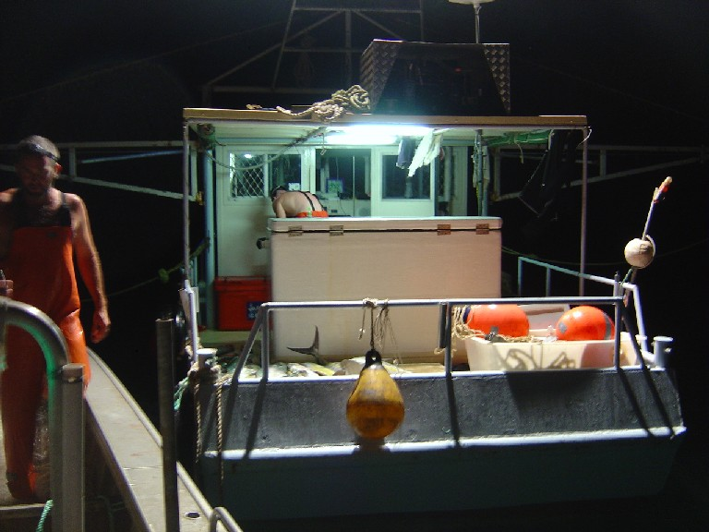
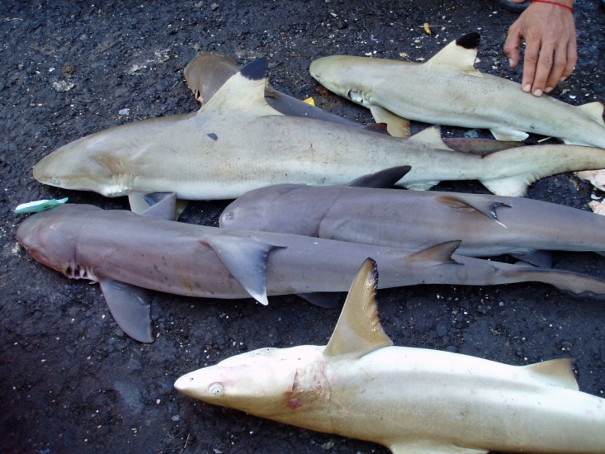
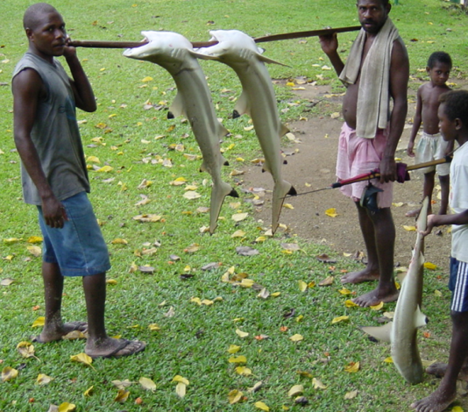
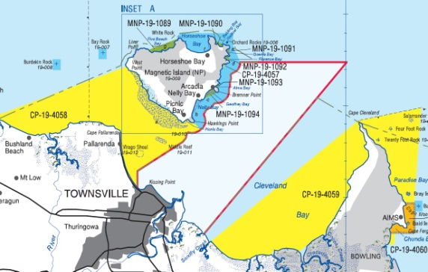
Does occurrence in TCEs matter?
Photo: William White
Exposure and protection?
Photo: Josh Cinner
Introduction Aims Methods Results Discussion Conclusions

Slide 7
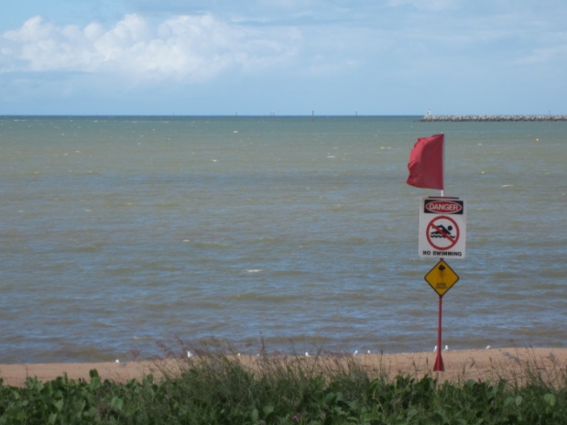
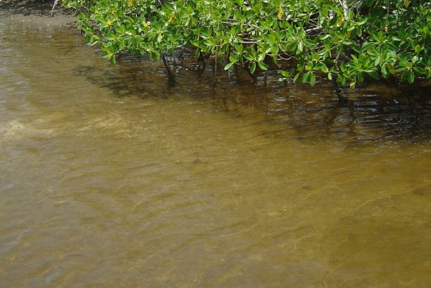
Main aims
Which reef sharks (if any) occur in TCEs?
Which types of TCEs do they use?
How do they use these habitats?
Introduction Aims Methods Results Discussion Conclusions

Slide 8

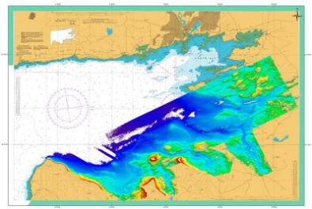

Methods 1+2: Identifying catch and habitats
Commercial fisheries observers
  Coastal net fishery
  3 years, Qld east coast,
  1188 samples
  Plotted sample locations and
  reef shark catch
Habitat classification - spatial data
  Satellite imagery, bathymetry
  models, seabed biodiversity project etc
  In-situ habitat & adjecnt biological features
Models to analyse reef shark catch vs
TCE habitats
which reef sharks occur in TCEs?
which types of TCE habitats do they occur in?
Introduction Aims Methods Results Discussion Conclusions

Slide 9
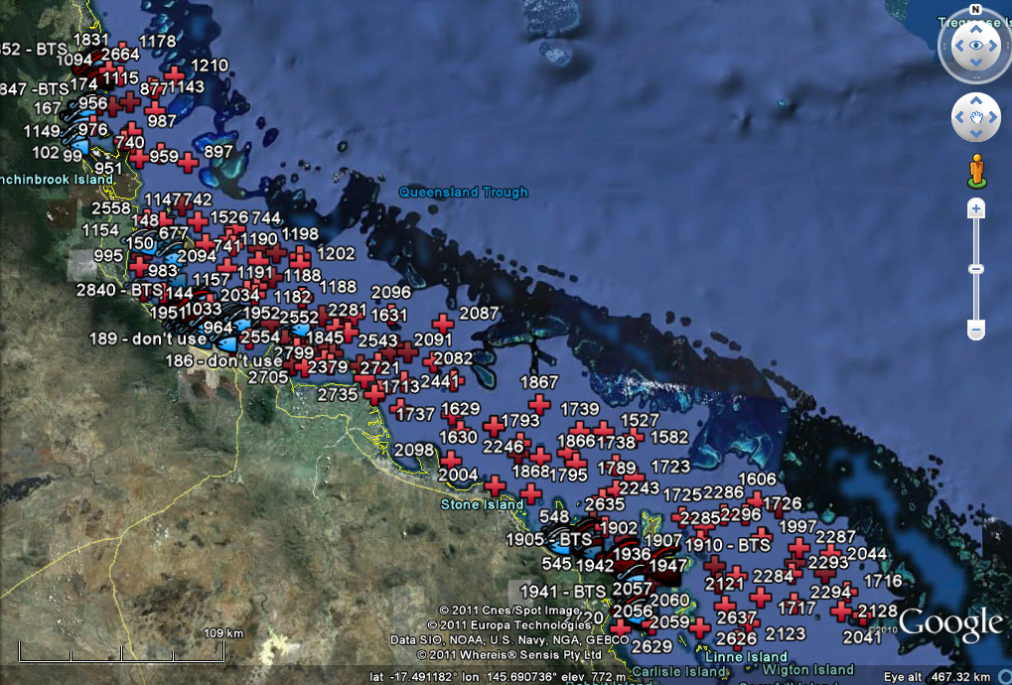

Slide 10
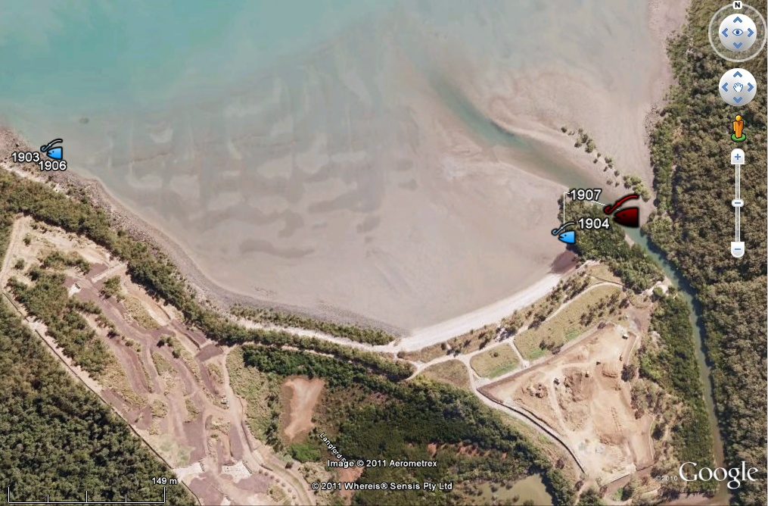
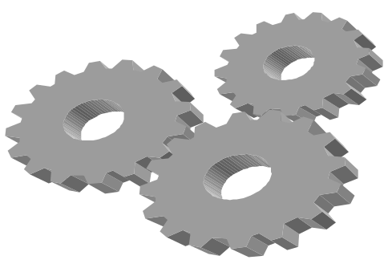
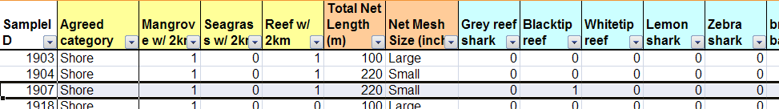
Methods 1+2: Identifying catch and habitats
R
AIC
Best models - highest AIC weight
(which factors best explain presence/absence)
Odds ratios
Relative probabilities
(which habitats/features are favourite reef shark ‘hang outs’
Introduction Aims Methods Results Discussion Conclusions

Slide 11
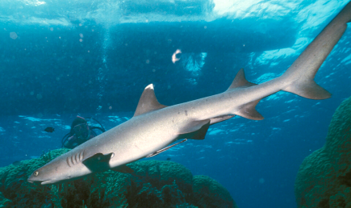
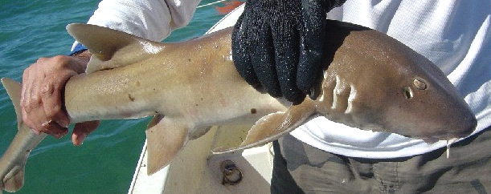
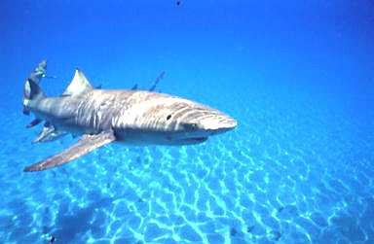
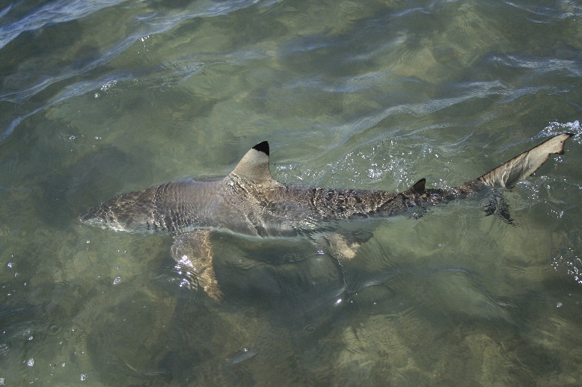
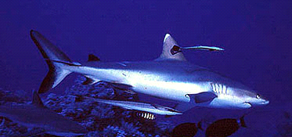
Results (1+2): Reef sharks and TCEs
Six reef shark species
encountered in TCEs
Blacktip reef shark most common
Catch data and model outputs
  Grey reef and whitetips
  exclusive to inshore reefs
  Leopard sharks away from
  reefs**
  Favour shallow shore
  environments, especially near inshore reefs and mangroves
which reef sharks occur in TCEs?
which types of TCE habitats do they occur in?
Introduction Aims Methods Results Discussion Conclusions

Slide 12
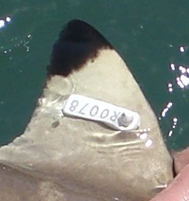
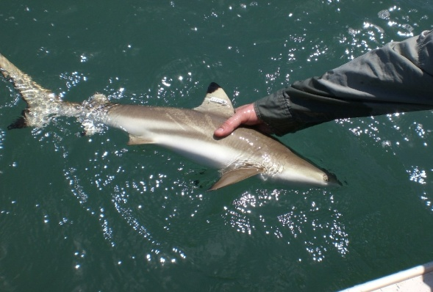
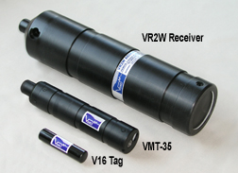
Methods (3): Tagging and tracking
Focal species: Carcharhinus melanopterus
Blacktip reef shark
Tag, release, recapture program
Acoustic telemetry
  27 internally implanted V16s
  October 2009 to Feb 2012 (2.3 years)
  Temporal residency
  Spatial use
Introduction Aims Methods Results Discussion Conclusions

Slide 13
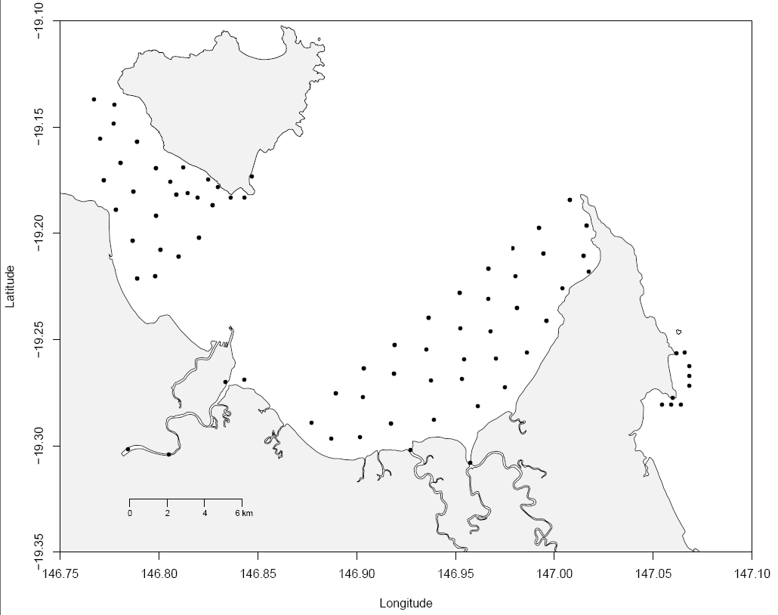
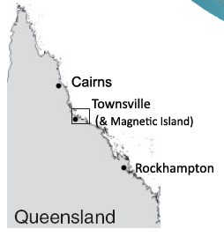
Methods (3): Tagging and tracking
74 Vemco VR2W receivers
Magnetic Island
Cleveland Bay
Townsville

Slide 14
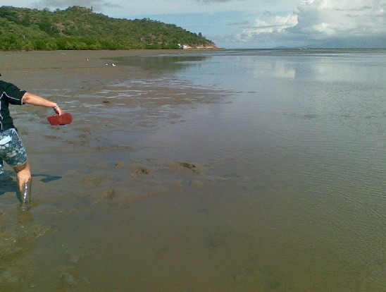
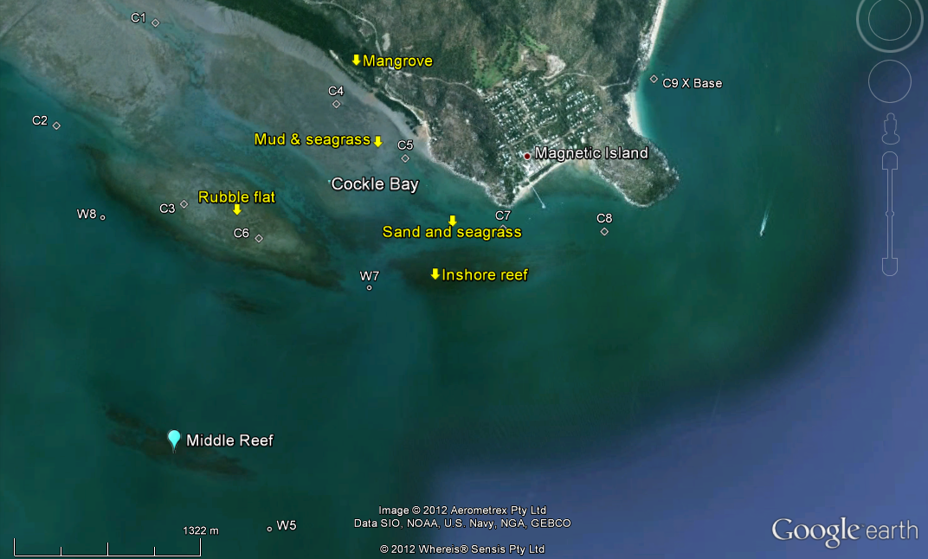
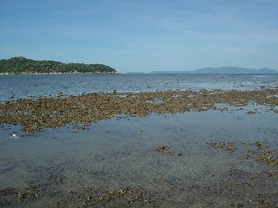
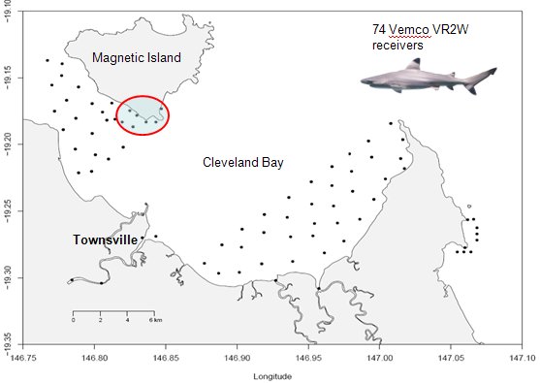
Methods (3): Tagging and tracking
Extensive inshore reef
Introduction Aims Methods Results Discussion Conclusions

Slide 15
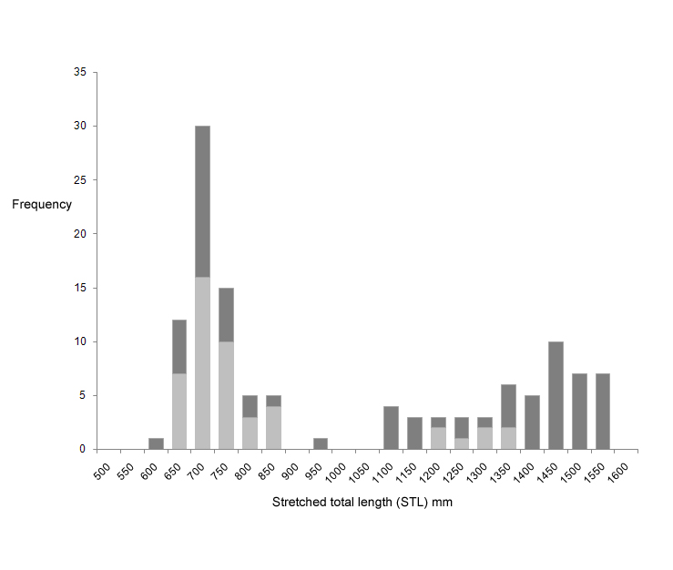



Results : Tagging and tracking
Highly structured population (n=127)
  almost no adult males
  No ‘teenagers’
X
X
Introduction Aims Methods Results Discussion Conclusions

Slide 16
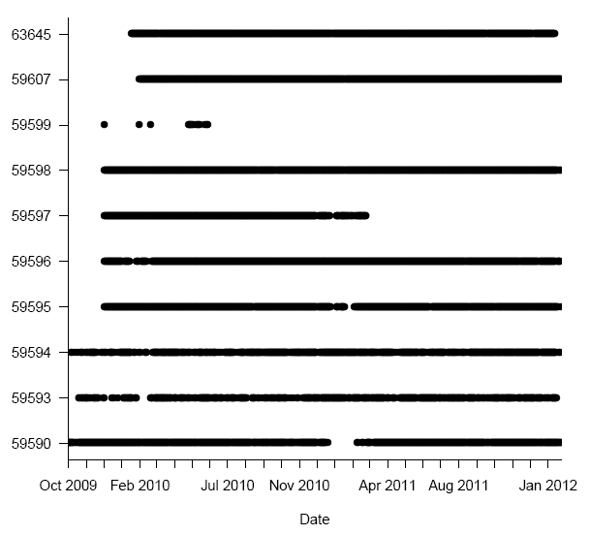
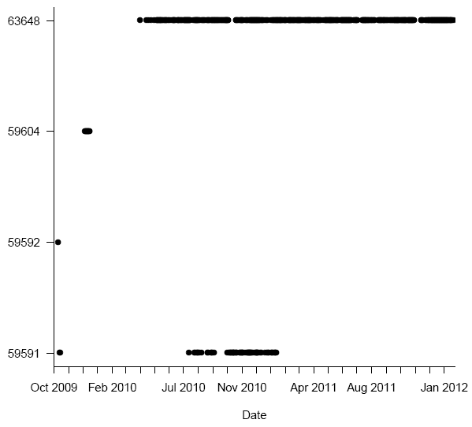
Results: Habitat use - residency
“Missing” size class
Adult females
Adult males
Introduction Aims Methods Results Discussion Conclusions

Slide 17
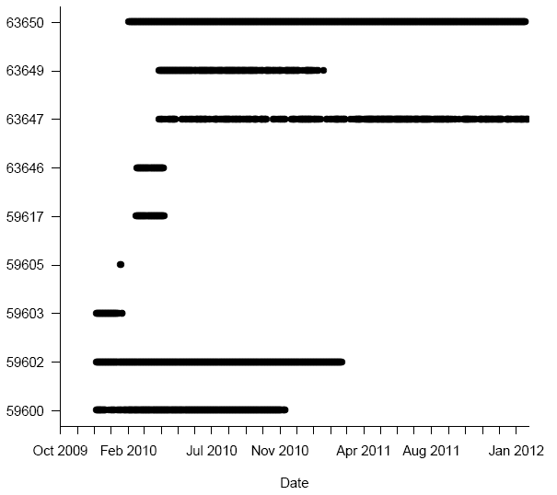
Results (3): Habitat use – residency/roaming
Adult females
  Highly resident
  High site attachment
Adult males
  Mostly vagrant
  Resident (1) high roaming
Juveniles
  Highly resident***
  High site attachment***
“Missing” size class
Introduction Aims Methods Results Discussion Conclusions

Slide 18
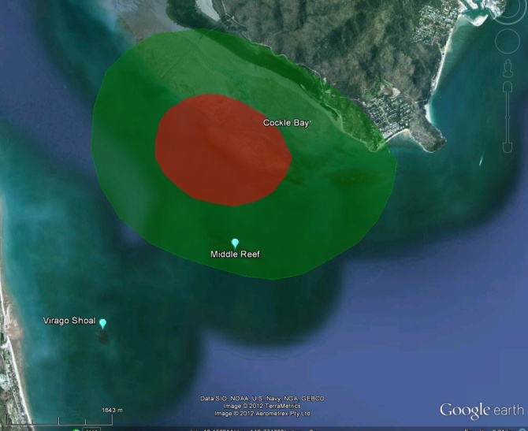
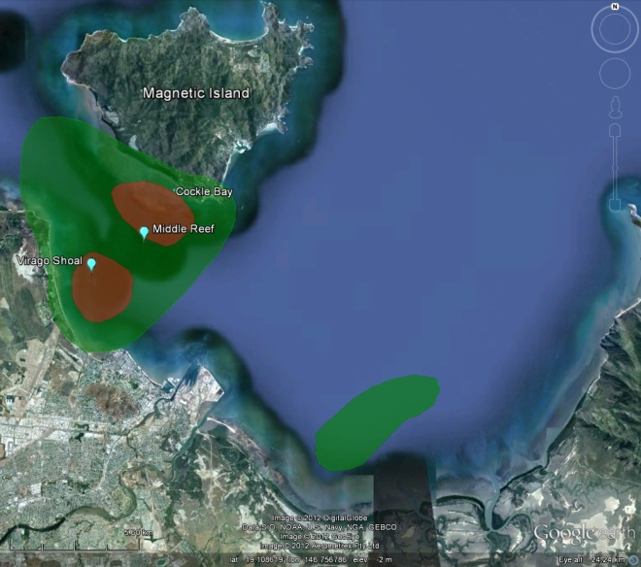
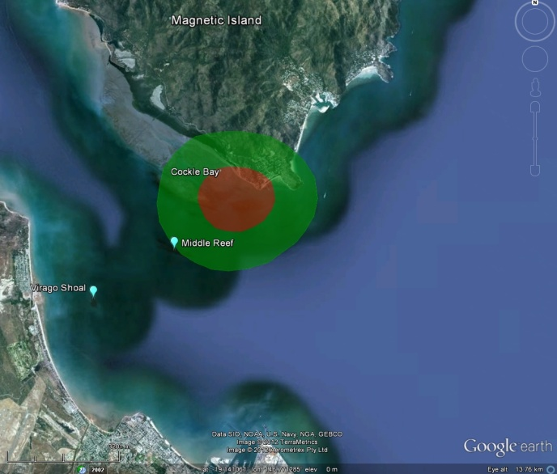
Results (3): Habitat use
Extensive inshore
reef
Extensive inshore reef
Adult female (59596)
50% KUD – 4.1 km²
95% KUD – 16.8 km²
Resident for whole study
Adult male (63648)
50% KUD – 14.6 km²
95% KUD – 74.1 km
Mainly vagrant
Juvenile (59600)
50% KUD – 3.2 km²
95% KUD – 14.2 km²
Resident until leaving
Introduction Aims Methods Results Discussion Conclusions

Slide 19
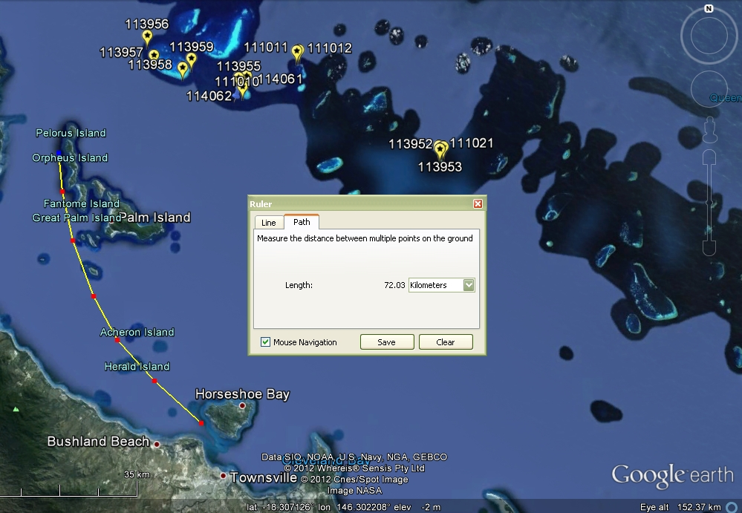
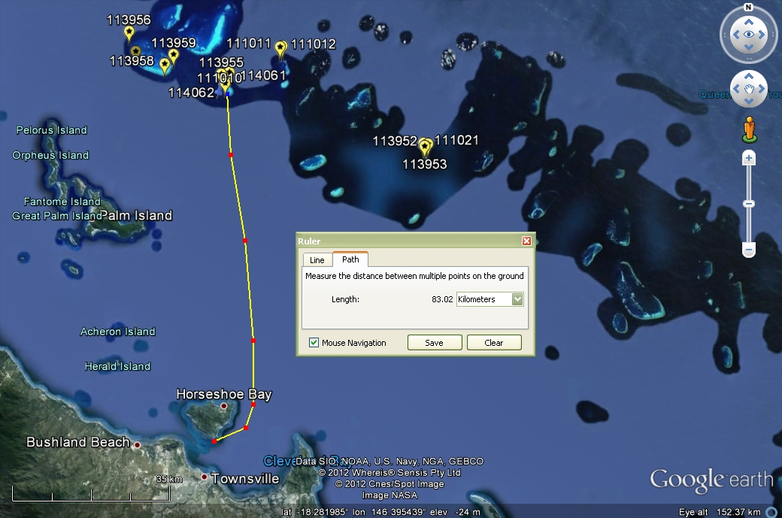
Results (3): Juvenile dispersal?
n = 112
Relatively high recapture rate (~20%)
Highest catch in summer
“Missing” size class
Introduction Aims Methods Results Discussion Conclusions

Slide 20
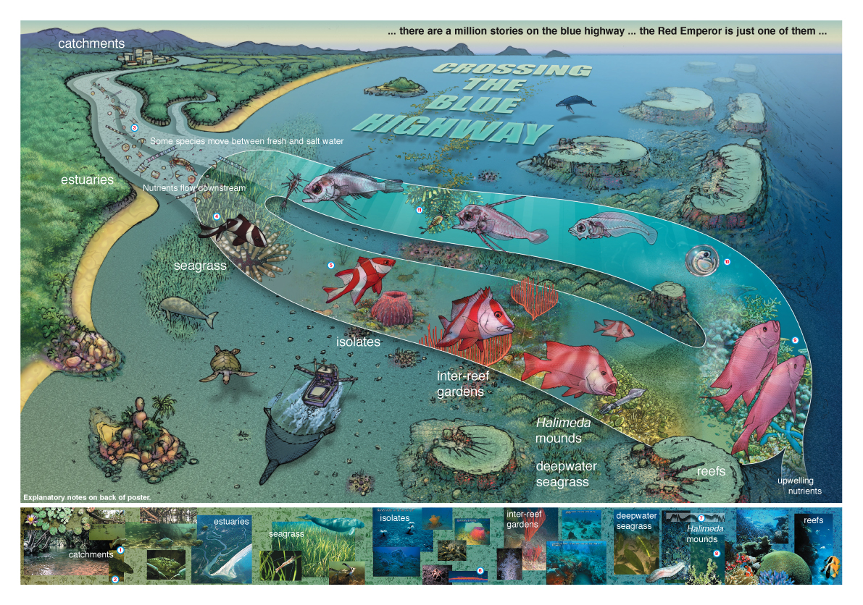


Slide 21
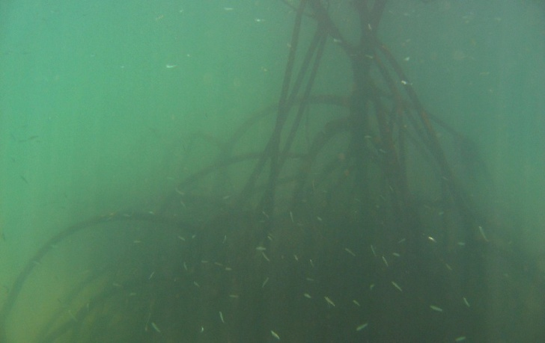
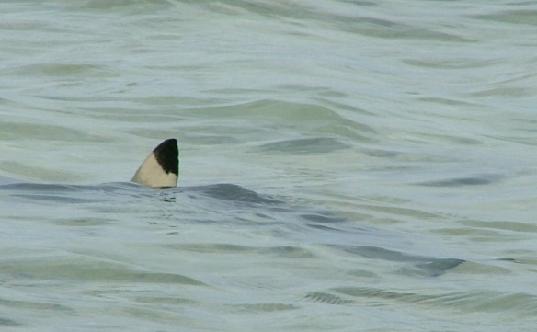
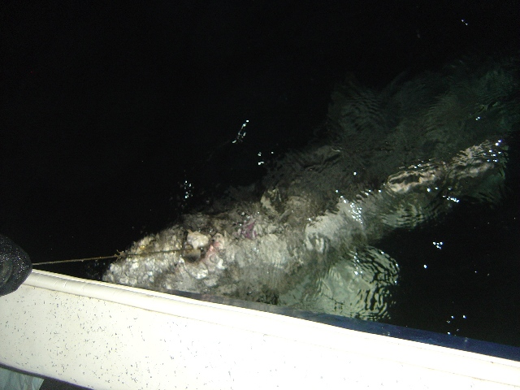
What does this ‘mean’?
Complex populations
  Population structuring, sample design . . .
TCEs ecologically significant ← → reef sharks significant effects on TCEs
Coastal habitats ← → coral reefs?
For fisheries and marine park managers . . .
Some reef sharks exposed to coastal fisheries
Cumulative pressures (habitat loss)
Coastal management may contribute to reef shark protection offshore
Introduction Aims Methods Results Discussion & Conclusions

Slide 22




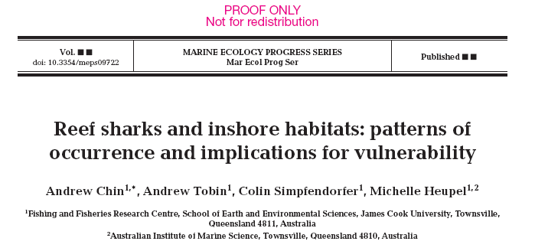


Many thanks to . . .
Funding
Marine and Tropical Science Research Facility
JCU – funding and scholarship
GBRMPA science for management award
Data collection and support
Fisheries observers and commercial fishers
Ms Sam Gibbs (JCU)
GBRMPA (SDC)
Seagrass folks
DEEDI

Slide 23

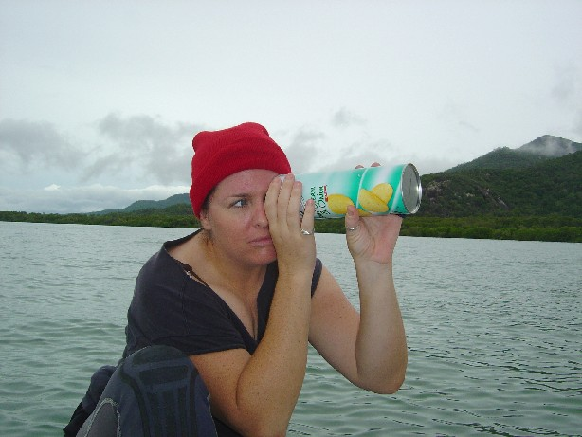

















Thanks to the crew . . .

Slide 24



  Questions?
  andrew.chin@jcu.edu.au
Introduction Aims Methods Results Discussion & Conclusions

Slide 25


Where to next?
Exposure VS adaptive capacity
  Exposure is ‘bad’, flexibility is ‘good’
  The ‘balance’ depends on the interaction – how species use NREs (dependence, roles, synergistic effects etc . . .)
  . . . which is why habitat use matters (and the reason for thesis chapters 4 and 5!)
Explore habitat use and connectivity
  tagging and telemetry
  population structure, diet
Introduction Aims Methods Results Discussion & Conclusions

Slide 26
Results summary
n = 112
Relatively high recapture rate (~20%)
Highest catch in summer
Variable occurrence in TCEs
  Four reef sharks often found in TCEs
Favour inshore reefs, mangroves and shallow shore habitats
For blacktip reef sharks in coastal habitats
Intertidal flats associated with inshore reefs and mangrove
Highly structured population
Females and juvs. highly resident and highly site attached
Juveniles then disperse
Introduction Aims Methods Results Discussion Conclusions

Slide 27
Results - Acoustic telemetry
27 ‘pinging’ individuals
Deployment times up to 2.3 years
 | Juvenile (695mm – 900mm) | Adult (1000mm – 1500mm)
Male | 9 | 5
Female | 3 | 10
Introduction Aims Methods Results Discussion Conclusions

Slide 28
Methods 1+2: Identifying catch and habitats
Catch data
  Which reef sharks occur in coastal fishery
Categorise catch vs habitats
  Spatial data to categorise habitats
  Catch per habitat plotted (0/1)
  SIX in situ habitat categories,
  and proximity to THREE
  biological features
River/estuary
Shore
Reef
Open (mud)
Open (sand)
Open (rocky)
Logistic Regression Generalised Linear
Models
  - which habitats and locations are best chances of
  encountering reef sharks?
Seagrass
Reef
Mangrove
Introduction Aims Methods Results Discussion Conclusions

Slide 29
Results (1): Reef sharks in the coastal fishery
Introduction Aims Methods Results Discussion Conclusions

Slide 30


Results (2): Reef shark occurrence in NREs
Habitat type | % catch per habitat type
Estuarine | 0 | 25 | 0 | 0 | 0 | 0
Shore | 93 | 75 | 14 | 0 | 67 | 0
Inshore reef | 7 | 0 | 0 | 100 | 0 | 100
Muddy open | 0 | 0 | 86 | 0 | 33 | 0
Sandy open | 0 | 0 | 0 | 0 | 0 | 0
Rocky open | 0 | 0 | 0 | 0 | 0 | 0
 | % of catch with proximity to an inshore coral reef
Inshore reef within 2 km | 98 | 75 | 25 | 100 | 66 | 100
Introduction Aims Methods Results Discussion Conclusions

Slide 31
Results (2): Reef shark occurrance in NREs
Model structure ANY REEF SHARK | df | AIC | ∆ AIC | AIC weight
Two factor habitat type + proximity to reef | 7 | 226.17 | 0.000000 | 0.357
Three factor habitat type + proximity to mangrove + proximity to reef | 8 | 227.38 | 1.209 | 0.195
Three factor habitat type + proximity to seagrass + proximity to reef | 8 | 228.17 | 1.997 | 0.131
Model structure BLACKTIP REEF SHARK | df | AIC | ∆ AIC | AIC weight
Two factor habitat type + proximity to reef | 7 | 123.36 | 0.000000 | 0.443
Three factor habitat type + proximity to seagrass + proximity to reef | 8 | 125.29 | 1.922 | 0.169
Three factor habitat type + proximity to mangrove + proximity to reef | 8 | 125.36 | 1.998 | 0.163
Introduction Aims Methods Results Discussion Conclusions

Slide 32


(2) Model outputs (odds ratios)
Habitat type: reef
Habitat type: shore
Proximity to reef
Introduction Aims Methods Results Discussion Conclusions

Slide 33


Results (2): Reef shark occurrence in NREs
Four reef sharks often found in NREs*
Best performing models to explain reef shark presence
  First – habitat + inshore reefs (AIC 0.357)
  Second – habitat + mangroves (AIC 0.195)
  Third – habitat + seagrasses (AIC 0.131)
Odds ratios (which habitats best places to find reef sharks)
  Inshore reef habitats
  Shore habitats
  *Leopard sharks most often caught in muddy open water substrates and away from reefs!
Introduction Aims Methods Results Discussion Conclusions

Slide 34
0
Data analysis - occurrence
1
1
0
0
Habitat type
Reef
Seagrass
0
0
1
Mangrove
16 Models
Results for 16 Models
Logistic regression
Generalised Linear
Model (Useful for
zero-inflated data
Aitcheson 1955; Mayer et al 2005; Webley et al 2011)
R
AIC
Best models - highest AIC weight
(which factors best explain presence/absence)
Odd ratios
Relative probabilities
(which habitats/features are favourite reef shark ‘hang outs’
Introduction Aims Methods Results Discussion Conclusions

